Slide 1
Prediction of Daily Average Traded Volume

Slide 2
Content
1
Extraction
2
Exploratory Data Analysis
3
Model Building
4
Model Evaluation
5
Prediction of Next Week Daily Average Traded Volume

Slide 3
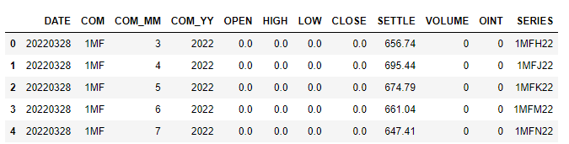
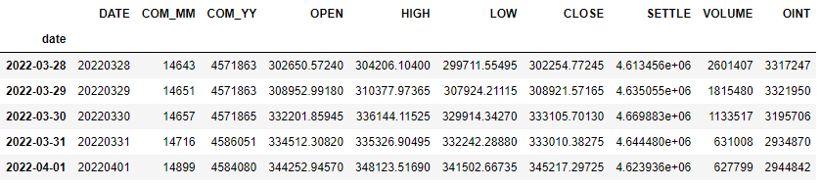
1. Extraction
1
Load dataset from file. Each row consists of transaction volume of 1 security. We want to predict the daily average traded volume. Hence, we need to take the total volume of all securities in 1 day.
1
3
2
We set the index of the table into date for time-series analysis later explained in next slides.
The dataset starts from 28th Mar 2022 to 17th Jun 2022, almost 3 months.
2
3
For analysis and prediction, we will use column “VOLUME”

Slide 4
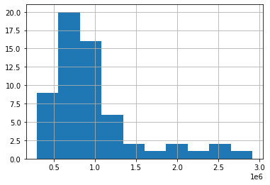
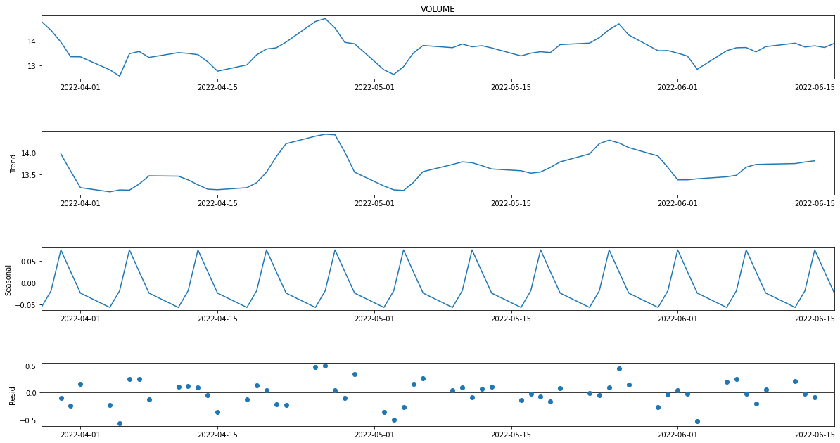
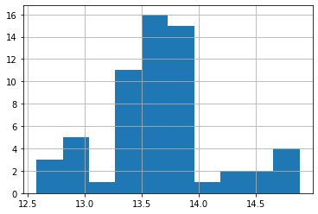
2. Exploratory Data Analysis
1
Check the data histogram.
From graph below, the distribution is right-skewed. We need to make it closer to normal distribution to make it easier for Machine Learning (ML) models to predict. We can take the natural logarithm of VOLUME.
2
Check seasonality
In the third graph below, we can see seasonality every 5 data points (working day) which corresponds to 1 working week. We will reduce the effect by calculating the daily average traded volume with simple moving average of 5 days.
Before
Skewness (should be 0): 1.788
3
1
2
After
Skewness: 0.238

Slide 5
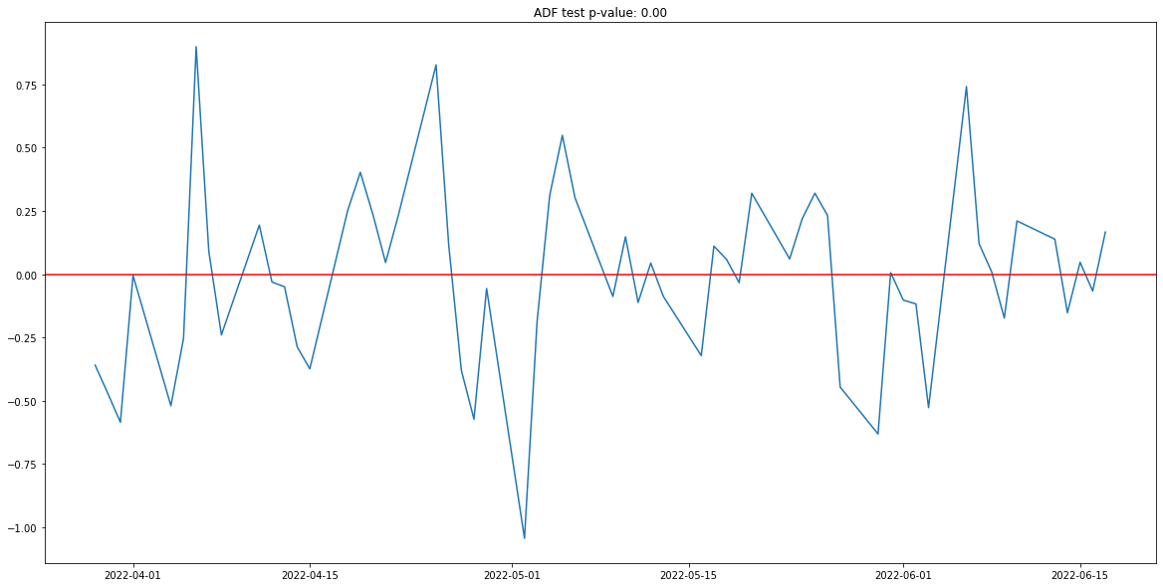
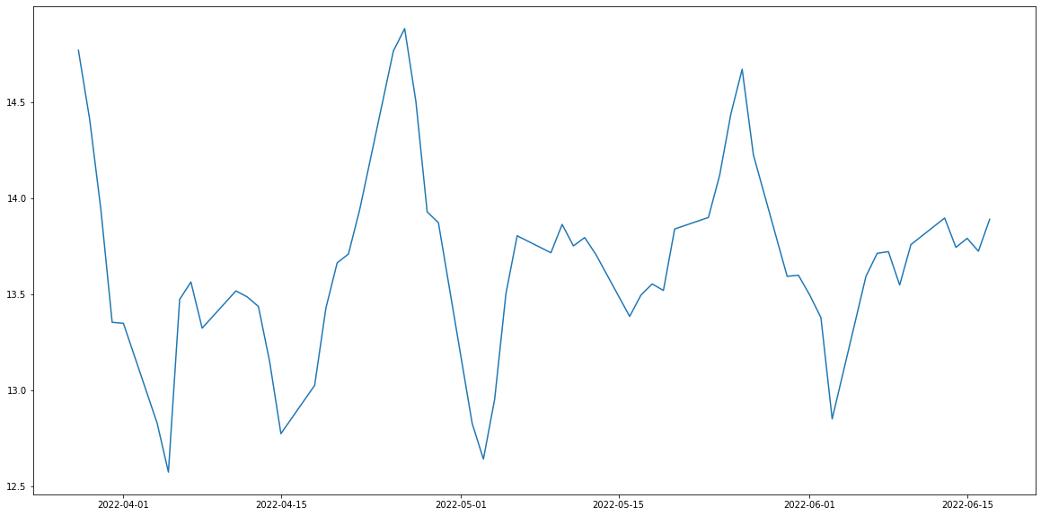
2. Exploratory Data Analysis
3
Check stationarity
From the previous graph, we suspect the data is non-stationary. We can test it further with ADF test.
If the p-value is less than 0.05, the data is stationary. Otherwise, the data is non-stationary and need transformation.
Because the data is non-stationary, we will transform it by taking the first order difference and redo ADF test to check if the data becomes stationary.
After
ADF test p-value: 0.0000
Before
ADF test p-value: 0.12
After calculating the first order difference, the data becomes stationary now.

Slide 6
2. Exploratory Data Analysis - Conclusion
There are 3 data transformations we will do before model exploration.
1
Take natural logarithm to reduce skewness.
3
Calculate the first order difference to make the data stationary.
2
Calculate the daily average traded volume with simple moving average of 5 days to remove seasonality.

Slide 7
3. Model Building
For this presentation, we will use 4 models to predict future daily average traded volume.
1
Auto ARIMA
The model considers trend, seasonality, and residual. The model will find the optimum parameters that minimizes Akaike Information Criterion (AIC) or prediction error.
3
XGBoost
We will add more features in our original dataset. Will be explained below.
2
Facebook Prophet
We will give timestamp and VOLUME data for training. The model considers trend, seasonality, holidays, and residual.
4
Neural Network (NN)
Use the same dataset as XGBoost. The NN model will consist of 4 dense layers.
For XGBoost and NN, we will add more features to the original one by taking the (1) day, (2) month, (3) quarter, (4) day of week, (5) day of year, (6) week of year, (7) year, and (8-12) the previous 5 values from the date. In total, we will use 12 features to predict today’s volume.
After training each model, we will calculate the Mean Absolute Error (MAE) of the model’s predicted values on test data and compare them to decide the best performing model.

Slide 8
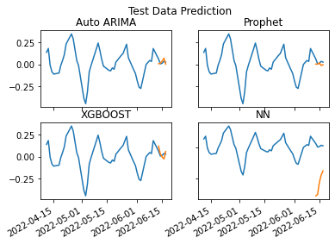
4. Model Evaluation
1
By comparing MAE, the best performing model is the Prophet Model. We will use this model to predict next week daily average traded volume.
2
We compare how the models perform in predicting test data.
We can see that Prophet and Auto ARIMA predictions are quite close. There is some spike in the XGBoost prediction. The prediction from NN model is the furthest from observation data.

Slide 9
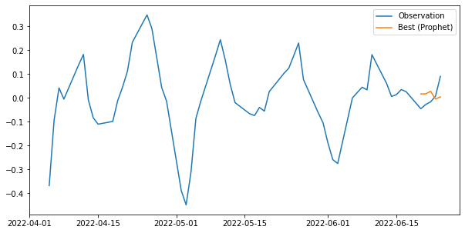
5. Prediction of Next Week Volume
Next is we will predict the next week volume. We collected the real values from SGX website* for the purpose of presentation.
Lesson learned
We can see that the prediction is quite downward biased. One reason is the dataset is quite short (3 months). However, we can improve the accuracy by increasing the size of our dataset, for example to at least 1 year, to provide more information to our models.
* SGX Website

Slide 10
Thank you.

